Slide 1
Uncertainty Estimation using Ensemble Model
Li Yin
2020-03-30
Notes:
Simple and scalable predictive uncertainty estimation using deep ensembles

Slide 2
Outline
Problem
Scoring Rules
Ensemble Model
Experiment Setup
Experimental Results
References
Notebook: n241029

Slide 3
Problem
Bayesian NNs are computationally expensive
Goal: Alternative to Bayesian NNs, less expensive, readily parallelizable model, and yields high quality predictive uncertainty estimates.

Slide 4
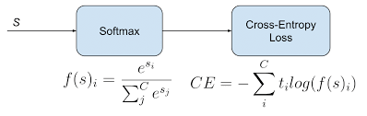
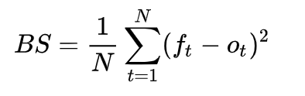
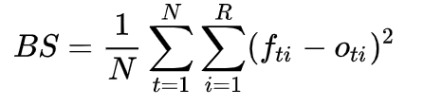
Scoring Rules
Measure the quality of predictive uncertainty
Methods Tried:
Softmax Cross Entropy Loss
Brier Score, a.k.a Mean Squared Error (MSE) Loss
Notes:
Many common NN loss functions are proper scoring rules.

Slide 5
Ensemble Model
Each single model has:
different set of random initialization
Different random shuffled data loader
Different optimizer and be trained separately
Each single model can be parallelized in training and testing
Other alternatives:
Bagging, a.k.a. Bootstrapping
Random Forest
Notes:
Bootstrap only uses a part of the dataset, it tries to induce diversity. However the NNs itself is full of randomness and diversity, using less data will only lead to worse performance.
To train each model separately is to de-correlate the predictions between each individual models as well as ensures that the individual models are high in accuracy

Slide 6
Experiment Setup
Datasets
Trained on MNIST
Tested on MNIST, FASHION-MNIST, and NOT-MNIST
Ensemble Training:
5 NNs
Tried Two Optimizer
Adam: converges faster
SGD: the most conventional optimizer
Adam VS SGD
Tried Two Loss Functions
Brier Score
Softmax Cross Entropy

Slide 7
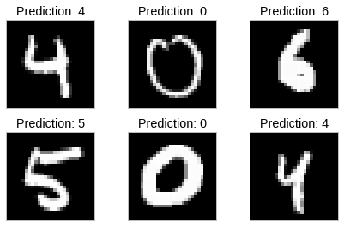
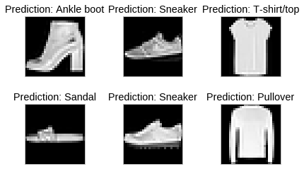
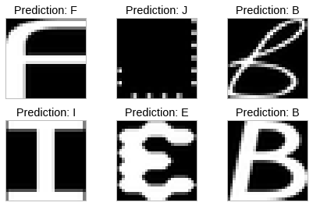

Slide 8
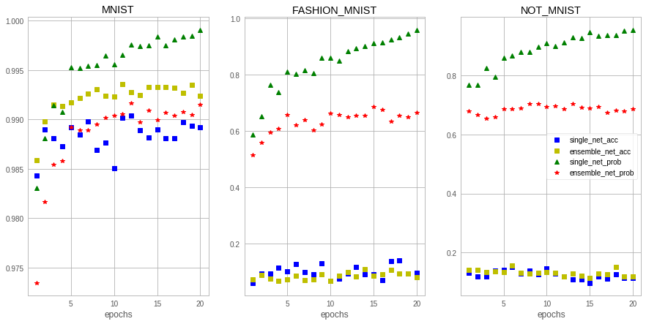
Experimental Results
Brier Score Loss and Adam Optimizer

Slide 9
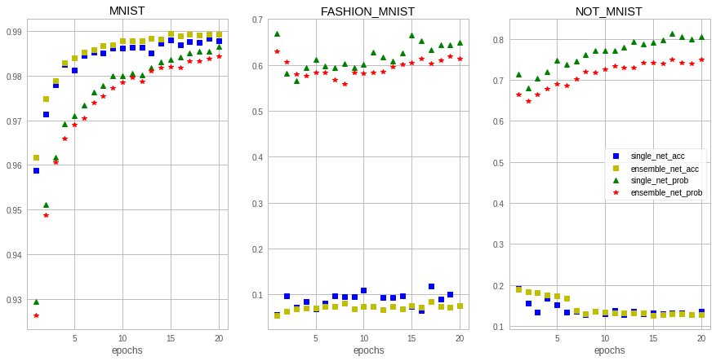
Experimental Results
Brier Score Loss and SGD Optimizer

Slide 10
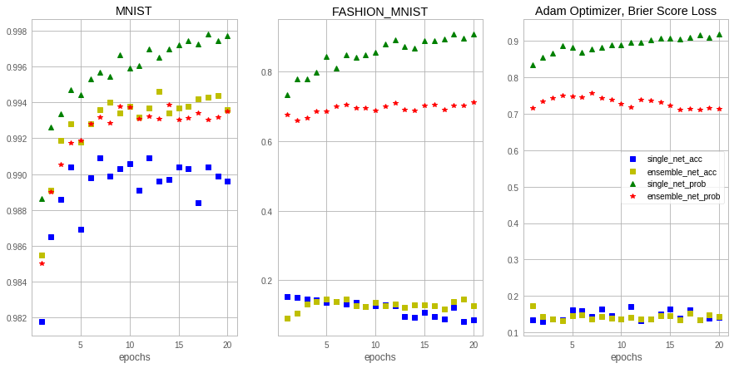
Experimental Results
Softmax Cross Entropy Loss and Adam Optimizer

Slide 11
Takeaways
Ensemble model is able to gain better accuracy, delay the overfitting, and shows higher uncertainty when it comes to out-of-distribution samples.
SGD optimizer is better than Adam optimizer to detect out-of-distribution examples.
To make a single model more resilient to out-of-distribution examples, avoid overfitting the model.

Slide 12
References
[1] Lakshminarayanan, Balaji, Alexander Pritzel, and Charles Blundell. "Simple and scalable predictive uncertainty estimation using deep ensembles." Advances in neural information processing systems. 2017.
[2]https://github.com/Kyushik/Predictive-Uncertainty-Estimation-using-Deep-Ensemble

